Slide 1
Advanced Graph Algorithm
Graph algorithm is the foundation of computer science?

Slide 2
Graph Algorithm
8.1Graph Search and its applications
8.2Minimum Spanning Trees
8.3The Shortest Paths Problems

Slide 3
8.1 Representations of graphs
The two standard ways to represent a graph G = (V, E):Adjacency lists and Adjacency matrix
Adjacency lists: represent sparse graphs-those for which |E| is much less than |V|².
Adjacency matrix: represent dense graphs-those for which |E| is close to |V|².

Slide 4
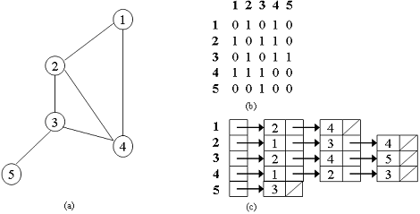
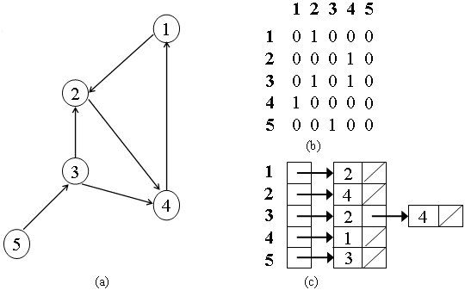
Adjacency matrix
Adjacency lists

Slide 5
8.1.1 Breadth-first search
Given a graph G =(V, E) and a distinguished source vertex s, breadth-first search systematically explores the edges of G to "discover" every vertex that is reachable from s. It computes the distance (smallest number of edges) from s to each reachable vertex. It also produces a "breadth-first tree" with root s that contains all reachable vertices.

Slide 6
BFS(G, s)
1 for each vertex u∈ V - {s} do
2 color[u] ← White
3 d[u] ← ∞
4 π[u] ← NIL
5 color[s] ← Gray
6 d[s] ← 0;π[s] ← NIL; Q ←Ø
7 Enqueue(Q, s)
8 while Q ≠Ø do
9 u ← Dequeue(Q)
10 for each v∈ Adj[u] do
11 if color[v] = White then
12 color[v]←Gray
13 d[v] ← d[u] + 1
14 π[v] ← u
15 Enqueue(Q, v)
16 color[u] ← DarkGray
Running time:
O(|V| +|E|)

Slide 7
An example
BFS(G, s)
1 for each vertex u∈ V - {s} do
2 color[u] ← White
3 d[u] ← ∞
4 π[u] ← NIL
5 color[s] ← Gray
6 d[s] ← 0;π[s] ← NIL; Q ←Ø
7 Enqueue(Q, s)
8 while Q ≠Ø do
9 u ← Dequeue(Q)
10 for each v∈ Adj[u] do
11 if color[v] = White then
12 color[v]←Gray
13 d[v] ← d[u] + 1
14 π[v] ← u
15 Enqueue(Q, v)
16 color[u] ← DarkGray
Q
s
r
s
t
u
∞
0
∞
∞
∞
∞
∞
∞
v
w
x
y

Slide 8
An example
BFS(G, s)
1 for each vertex u∈ V - {s} do
2 color[u] ← White
3 d[u] ← ∞
4 π[u] ← NIL
5 color[s] ← Gray
6 d[s] ← 0;π[s] ← NIL; Q ←Ø
7 Enqueue(Q, s)
8 while Q ≠Ø do
9 u ← Dequeue(Q)
10 for each v∈ Adj[u] do
11 if color[v] = White then
12 color[v]←Gray
13 d[v] ← d[u] + 1
14 π[v] ← u
15 Enqueue(Q, v)
16 color[u] ← DarkGray
Q
r w
1
1
r
s
t
u
1
0
∞
∞
∞
1
∞
∞
v
w
x
y

Slide 9
An example
BFS(G, s)
1 for each vertex u∈ V - {s} do
2 color[u] ← White
3 d[u] ← ∞
4 π[u] ← NIL
5 color[s] ← Gray
6 d[s] ← 0;π[s] ← NIL; Q ←Ø
7 Enqueue(Q, s)
8 while Q ≠Ø do
9 u ← Dequeue(Q)
10 for each v∈ Adj[u] do
11 if color[v] = White then
12 color[v]←Gray
13 d[v] ← d[u] + 1
14 π[v] ← u
15 Enqueue(Q, v)
16 color[u] ← DarkGray
Q
w v
1
2
r
s
t
u
1
0
∞
∞
2
1
∞
∞
v
w
x
y

Slide 10
An example
BFS(G, s)
1 for each vertex u∈ V - {s} do
2 color[u] ← White
3 d[u] ← ∞
4 π[u] ← NIL
5 color[s] ← Gray
6 d[s] ← 0;π[s] ← NIL; Q ←Ø
7 Enqueue(Q, s)
8 while Q ≠Ø do
9 u ← Dequeue(Q)
10 for each v∈ Adj[u] do
11 if color[v] = White then
12 color[v]←Gray
13 d[v] ← d[u] + 1
14 π[v] ← u
15 Enqueue(Q, v)
16 color[u] ← DarkGray
Q
v t x
2
2
2
r
s
t
u
1
0
2
∞
2
1
2
∞
v
w
x
y

Slide 11
An example
BFS(G, s)
1 for each vertex u∈ V - {s} do
2 color[u] ← White
3 d[u] ← ∞
4 π[u] ← NIL
5 color[s] ← Gray
6 d[s] ← 0;π[s] ← NIL; Q ←Ø
7 Enqueue(Q, s)
8 while Q ≠Ø do
9 u ← Dequeue(Q)
10 for each v∈ Adj[u] do
11 if color[v] = White then
12 color[v]←Gray
13 d[v] ← d[u] + 1
14 π[v] ← u
15 Enqueue(Q, v)
16 color[u] ← DarkGray
Q
t x
2
2
r
s
t
u
1
0
2
∞
2
1
2
∞
v
w
x
y

Slide 12
An example
BFS(G, s)
1 for each vertex u∈ V - {s} do
2 color[u] ← White
3 d[u] ← ∞
4 π[u] ← NIL
5 color[s] ← Gray
6 d[s] ← 0;π[s] ← NIL; Q ←Ø
7 Enqueue(Q, s)
8 while Q ≠Ø do
9 u ← Dequeue(Q)
10 for each v∈ Adj[u] do
11 if color[v] = White then
12 color[v]←Gray
13 d[v] ← d[u] + 1
14 π[v] ← u
15 Enqueue(Q, v)
16 color[u] ← DarkGray
Q
x u
2
3
r
s
t
u
1
0
2
3
2
1
2
∞
v
w
x
y

Slide 13
An example
BFS(G, s)
1 for each vertex u∈ V - {s} do
2 color[u] ← White
3 d[u] ← ∞
4 π[u] ← NIL
5 color[s] ← Gray
6 d[s] ← 0;π[s] ← NIL; Q ←Ø
7 Enqueue(Q, s)
8 while Q ≠Ø do
9 u ← Dequeue(Q)
10 for each v∈ Adj[u] do
11 if color[v] = White then
12 color[v]←Gray
13 d[v] ← d[u] + 1
14 π[v] ← u
15 Enqueue(Q, v)
16 color[u] ← DarkGray
Q
u y
3
3
r
s
t
u
1
0
2
3
2
1
2
3
v
w
x
y

Slide 14
An example
BFS(G, s)
1 for each vertex u∈ V - {s} do
2 color[u] ← White
3 d[u] ← ∞
4 π[u] ← NIL
5 color[s] ← Gray
6 d[s] ← 0;π[s] ← NIL; Q ←Ø
7 Enqueue(Q, s)
8 while Q ≠Ø do
9 u ← Dequeue(Q)
10 for each v∈ Adj[u] do
11 if color[v] = White then
12 color[v]←Gray
13 d[v] ← d[u] + 1
14 π[v] ← u
15 Enqueue(Q, v)
16 color[u] ← DarkGray
Q
y
3
r
s
t
u
1
0
2
3
2
1
2
3
v
w
x
y

Slide 15
An example
BFS(G, s)
1 for each vertex u∈ V - {s} do
2 color[u] ← White
3 d[u] ← ∞
4 π[u] ← NIL
5 color[s] ← Gray
6 d[s] ← 0;π[s] ← NIL; Q ←Ø
7 Enqueue(Q, s)
8 while Q ≠Ø do
9 u ← Dequeue(Q)
10 for each v∈ Adj[u] do
11 if color[v] = White then
12 color[v]←Gray
13 d[v] ← d[u] + 1
14 π[v] ← u
15 Enqueue(Q, v)
16 color[u] ← DarkGray
Q
r
s
t
u
1
0
2
3
2
1
2
3
v
w
x
y

Slide 16
Shortest paths
Define 8.1 The shortest path distance δ(s, v) from s to v is the minimum number of edges in any path from vertex s to vertex v; if there is no path from s to v, then δ(s, v) = ∞.
Lemma 8.1 Let G = (V, E) be a directed or undirected graph, and let s∈V be an arbitrary vertex. Then,for any edge (u, v)∈E,
δ(s, v) ≤δ(s, u) + 1.

Slide 17
Lemma 8.2 Let G = (V, E) be a directed or undirected graph, and suppose that BFS is run on G from a given source vertex s∈V. Then upon termination, for each vertex v∈ V, the value d[v] computed by BFS satisfies d[v]≥δ(s, v).
Proof We use induction on the number of Enqueue operations. n=1,d[s] = 0 =δ(s, s) and d[v] =∞≥ (s, v) for all v∈V - {s}.
n=k, d[u] ≥δ(s, u).
n=k+1, d[v] = d[u] + 1≥δ(s, u) + 1≥δ(s, v).

Slide 18
Lemma 8.3 Suppose that during the execution of BFS on a graph G = (V, E), the queue Q contains the vertices v₁, v₂,..., v_{r}, where v₁ is the head of Q and v_{r} is the tail. Then, d[v_{r}] ≤ d[v₁] + 1 and d[v_{i} ] ≤ d[v_{i+1}] for i = 1, 2,..., r - 1.
Proof We use induction on the number of queue operations to prove that the lemma holds after both dequeuing and enqueuing a vertex.

Slide 19
If the head v₁ of the queue is dequeued, v₂ becomes the new head. By the inductive hypothesis, d[v₁] ≤d[v₂]. But then we have d[v_{r}] ≤ d[v₁] + 1 ≤ d[v₂] + 1
If a vertex v is enqueued, it becomes v_{r+1}.
the inductive hypothesis,the new head v₁ has d[v₁] ≥ d[u]. Thus, d[v_{r+1}] = d[v] = d[u] + 1 ≤ d[v₁] + 1. From the inductive hypothesis, we also have d[v_{r}] ≤ d[u] + 1, and so d[v_{r}] ≤ d[u] + 1 = d[v] = d[v_{r+1}],

Slide 20
Corollary 8.1 Suppose that vertices v_{i} and v_{j} are enqueued during the execution of BFS, and that v_{i} is enqueued before v_{j} . Then d[v_{i}] ≤ d[v_{j} ] at the time that v_{j} is enqueued.

Slide 21
Theorem 8.1: (Correctness of breadth-first search)
Let G = (V, E) be a directed or undirected graph, and suppose that BFS is run on G from a given source vertex s ∈ V . Then, during its execution, BFS discovers every vertex v∈ V that is reachable from the source s, and upon termination, d[v] = δ(s, v) for all v∈ V . Moreover, for any vertex v ≠ s that is reachable from s, one of the shortest paths from s to v is a shortest path from s to π[v] followed by the edge (π[v], v).

Slide 22
Proof Assume that some vertex receives a d value not equal to its shortest path distance. Let v be the vertex with minimum δ(s, v) that receives such an incorrect d value. By Lemma 8.2, d[v] ≥δ(s, v), and thus we have that d[v] >δ(s, v). Let u be the vertex immediately preceding v on a shortest path from s to v, so that δ(s, v) = δ(s, u) + 1.
Because δ(s, u) < δ(s, v), and because of how we chose v, and have d[u] =δ(s, u). Putting these
properties together, we have

Slide 23
d[v] >δ(s, v) = δ(s, u) + 1= d[u]+1.
If v is white, then line 15 sets d[v] = d[u] + 1.
If v is black, then it was already removed from the queue and, by Corollary 8.1, we have d[v]≤d[u].
If v is gray, then it was painted gray upon dequeuing some vertex w, which was removed from Q earlier than u and for which d[v] = d[w] + 1. By Corollary 8.1, however, d[w] ≤ d[u], and so we have d[v] ≤d[u] + 1.

Slide 24
Breadth-first tree: For a graph G = (V,E) with source s, we define the predecessor subgraph of G as G_{π} = (V_{π}, E_{π}), where V_{π} = {v∈ V: π[v] ≠ NIL}∪{ s}
And E_{π} = {(π[v], v) : v∈V_{π} - {s}}.
The predecessor subgraph G_{π} is a breadth-first tree if V_{π} consists of the vertices reachable from s and, for all v ∈ V_{π} , there is a unique simple path from s to v in G_{π} that is also a shortest path from s to v in G.

Slide 25
PrintPath(G, s, v)
1 if v = s then
2 print s
3 else if π[v] = NIL then
4 print "no path from" s "to" v "exists"
5 else PrintPath(G, s, π[v])
6 print v

Slide 26
8.1.2 Depth-first search
The predecessor subgraph of a breadth-first search forms a breadth-first tree
The predecessor subgraph of a depth-first search forms a depth-first forest composed of several depth-first trees.
Depth- first search timestamps each vertex. Each vertex v has two timestamps: the first timestamp d[v] records when v is first discovered, and the second timestamp f [v] records when the search finishes examining v's adjacency list.

Slide 27
DFS(G)
1 for each vertex u∈V do
2 color[u] ← White
3 π[u] ← NIL
4 time ← 0
5 for each vertex u∈V do
6 if color[u] = White then
7 DFSVisit(u)
Running time:
O(|V| +|E|)
DFSVisit(u)
1 color[u] ← Gray
2 time ← time +1
3 d[u] ← time
4 for each v∈ Adj[u] do
5 if color[v] = White then
6 π[v] ← u
7 DFSVisit(v)
8 color[u] ← DarkGray
9 time ← time +1
10 f [u] ← time

Slide 28
An example
d[v]/f [v]
DFS(G)
1 for each vertex u∈V do
2 color[u] ← White
3 π[u] ← NIL
4 time ← 0
5 for each vertex u∈V do
6 if color[u] = White then DFSVisit(u)
DFSVisit(u)
1 color[u] ← Gray
2 time ← time +1
3 d[u] ← time
4 for each v∈ Adj[u] do
5 if color[v] = White then
6 π[v] ← u
7 DFSVisit(v)
8 color[u] ← DarkGray
9 time ← time +1
10 f [u] ← time
u
v
w
1/
x
y
z
u
v
w
1/
2/
x
y
z

Slide 29
An example
d[v]/f [v]
DFS(G)
1 for each vertex u∈V do
2 color[u] ← White
3 π[u] ← NIL
4 time ← 0
5 for each vertex u∈V do
6 if color[u] = White then DFSVisit(u)
DFSVisit(u)
1 color[u] ← Gray
2 time ← time +1
3 d[u] ← time
4 for each v∈ Adj[u] do
5 if color[v] = White then
6 π[v] ← u
7 DFSVisit(v)
8 color[u] ← DarkGray
9 time ← time +1
10 f [u] ← time
u
v
w
1/
2/
x
y
z
u
v
w
1/
2/
3/
x
y
z

Slide 30
An example
d[v]/f [v]
DFS(G)
1 for each vertex u∈V do
2 color[u] ← White
3 π[u] ← NIL
4 time ← 0
5 for each vertex u∈V do
6 if color[u] = White then DFSVisit(u)
DFSVisit(u)
1 color[u] ← Gray
2 time ← time +1
3 d[u] ← time
4 for each v∈ Adj[u] do
5 if color[v] = White then
6 π[v] ← u
7 DFSVisit(v)
8 color[u] ← DarkGray
9 time ← time +1
10 f [u] ← time
u
v
w
1/
2/
3/
x
y
z
u
v
w
1/
2/
4/
3/
x
y
z

Slide 31
An example
d[v]/f [v]
DFS(G)
1 for each vertex u∈V do
2 color[u] ← White
3 π[u] ← NIL
4 time ← 0
5 for each vertex u∈V do
6 if color[u] = White then DFSVisit(u)
DFSVisit(u)
1 color[u] ← Gray
2 time ← time +1
3 d[u] ← time
4 for each v∈ Adj[u] do
5 if color[v] = White then
6 π[v] ← u
7 DFSVisit(v)
8 color[u] ← DarkGray
9 time ← time +1
10 f [u] ← time
u
v
w
1/
2/
B
4/
3/
x
y
z
u
v
w
1/
2/
B
4/5
3/
x
y
z

Slide 32
An example
d[v]/f [v]
DFS(G)
1 for each vertex u∈V do
2 color[u] ← White
3 π[u] ← NIL
4 time ← 0
5 for each vertex u∈V do
6 if color[u] = White then DFSVisit(u)
DFSVisit(u)
1 color[u] ← Gray
2 time ← time +1
3 d[u] ← time
4 for each v∈ Adj[u] do
5 if color[v] = White then
6 π[v] ← u
7 DFSVisit(v)
8 color[u] ← DarkGray
9 time ← time +1
10 f [u] ← time
u
v
w
1/
2/
B
4/5
3/6
x
y
z
u
v
w
1/
2/7
B
4/5
3/6
x
y
z

Slide 33
An example
d[v]/f [v]
DFS(G)
1 for each vertex u∈V do
2 color[u] ← White
3 π[u] ← NIL
4 time ← 0
5 for each vertex u∈V do
6 if color[u] = White then DFSVisit(u)
DFSVisit(u)
1 color[u] ← Gray
2 time ← time +1
3 d[u] ← time
4 for each v∈ Adj[u] do
5 if color[v] = White then
6 π[v] ← u
7 DFSVisit(v)
8 color[u] ← DarkGray
9 time ← time +1
10 f [u] ← time
u
v
w
1/8
2/7
B
F
4/5
3/6
x
y
z
u
v
w
1/8
2/7
9/
B
C
F
4/5
3/6
x
y
z

Slide 34
An example
d[v]/f [v]
DFS(G)
1 for each vertex u∈V do
2 color[u] ← White
3 π[u] ← NIL
4 time ← 0
5 for each vertex u∈V do
6 if color[u] = White then DFSVisit(u)
DFSVisit(u)
1 color[u] ← Gray
2 time ← time +1
3 d[u] ← time
4 for each v∈ Adj[u] do
5 if color[v] = White then
6 π[v] ← u
7 DFSVisit(v)
8 color[u] ← DarkGray
9 time ← time +1
10 f [u] ← time
u
v
w
1/8
2/7
9/
B
C
F
4/5
3/6
10/
x
y
z
u
v
w
1/8
2/7
9/
B
C
F
4/5
3/6
10/
B
x
y
z

Slide 35
An example
d[v]/f [v]
DFS(G)
1 for each vertex u∈V do
2 color[u] ← White
3 π[u] ← NIL
4 time ← 0
5 for each vertex u∈V do
6 if color[u] = White then DFSVisit(u)
DFSVisit(u)
1 color[u] ← Gray
2 time ← time +1
3 d[u] ← time
4 for each v∈ Adj[u] do
5 if color[v] = White then
6 π[v] ← u
7 DFSVisit(v)
8 color[u] ← DarkGray
9 time ← time +1
10 f [u] ← time
u
v
w
1/8
2/7
9/
B
C
F
4/5
3/6
10/
B
x
y
z
u
v
w
1/8
2/7
9/
B
C
F
4/5
3/6
10/11
B
x
y
z

Slide 36
An example
d[v]/f [v]
DFS(G)
1 for each vertex u∈V do
2 color[u] ← White
3 π[u] ← NIL
4 time ← 0
5 for each vertex u∈V do
6 if color[u] = White then DFSVisit(u)
DFSVisit(u)
1 color[u] ← Gray
2 time ← time +1
3 d[u] ← time
4 for each v∈ Adj[u] do
5 if color[v] = White then
6 π[v] ← u
7 DFSVisit(v)
8 color[u] ← DarkGray
9 time ← time +1
10 f [u] ← time
u
v
w
1/8
2/7
9/
B
C
F
4/5
3/6
10/11
B
x
y
z
u
v
w
1/8
2/7
9/12
B
C
F
4/5
3/6
10/11
B
x
y
z

Slide 37
Properties of depth-first search
The predecessor subgraph G_{π} does indeed form a forest of trees.
Discovery and finishing times meet have parenthesis structure.
The search can be used to classify the edges of the input graph G = (V, E) into four edges:
1. Tree edges, 2. Back edges (B),
3. Forward edges (F), 4. Cross edges (C)

Slide 38
Application1: Topological sort
A topological sort of a dag G =(V, E) is a linear ordering of all its vertices such that if G contains an edge (u, v), then u appears before v in the ordering.

Slide 39
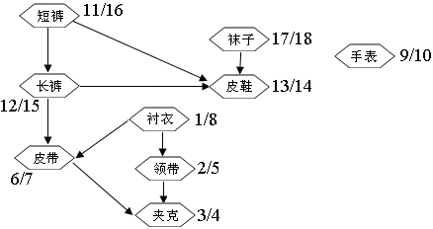
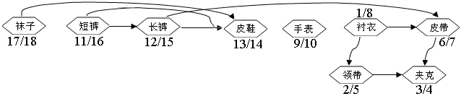

Slide 40
TopologicalSort(G)
1 call DFS(G) to compute finishing times f[v] for each vertex v
2 as each vertex is finished, insert it onto the front of a linked list
3 return the linked list of vertices

Slide 41
Application2: Strongly connected components
A strongly connected component of a directed graph G = (V, E) is a maximal set of vertices C⊆V such that for every pair of vertices u and v in C, we have both
u v and v u
that is, vertices u and v are reachable from each other.

Slide 42
StrongConnectedComponents(G)
1 call DFS(G) to compute finishing times f[u] for each vertex u
2 compute G^{T}
3 call DFS (G^{T}), but in the main loop of DFS, consider the vertices in order of decreasing f[u] (as computed in line 1)
4 output the vertices of each tree in the depth-first forest formed in line 3 as a separate strongly connected component

Slide 43
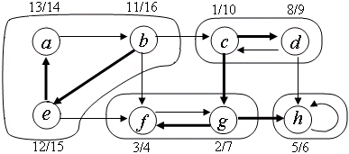
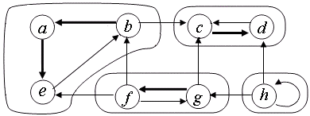

Slide 44
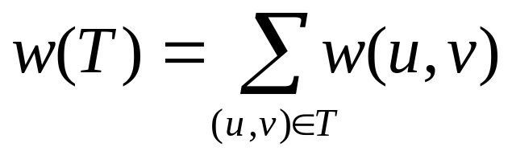
8.2 The minimum-spanning-tree problem
Given a connected, undirected graph G = (V, E), for each edge (u, v) ∈ E, we have a weight w(u, v) specifying the cost to connect u and v. We then wish to find an acyclic subset T⊆E that connects all of the vertices and whose total weight
is minimized.

Slide 45
b
8
c
7
d
4
2
9
8
i
14
a
4
e
7
6
8
10
h
g
f
1
2
Two greedy algorithms for solving the minimum-spanning-tree problem:
Kruskal's algorithm and Prim's algorithm.
This greedy strategy is to grow the minimum spanning tree one edge at a time.

Slide 46
The algorithms of Kruskal and Prim
Kruskal's algorithm is a greedy algorithm, because at each step it adds to the forest an edge of least possible weight.
Let the operation FindSet(u) returns a representative element from the set that contains u.
The combining of trees is accomplished by the Union procedure.

Slide 47
MSTKruskal(G, w)
1 A ← Ø
2 for each vertex v∈V do
3 MakeSet(v)
4 sort the edges of E by weight w
5 for each edge (u, v)∈E do
6 if FindSet(u) ≠ FindSet(v) then
7 A ← A∪{(u, v)}
8 Union(u, v)
9 return A
O(|E|lg|V|)
O(|V|)
O(|E|lg|E|)
O(|E|)
O(lg|V|)

Slide 48
An example
2
19
9
14
17
8
25
5
MSTKruskal(G, w)
1 A ← Ø
2 for each vertex v∈V do
3 MakeSet(v)
4 sort the edges of E by weight w
5 for each edge (u, v)∈E do
6 if FindSet(u) ≠ FindSet(v) then
7 A ← A∪{(u, v)}
8 Union(u, v)
9 return A
21
13
1

Slide 49
An example
2
19
9
14
17
8
25
5
MSTKruskal(G, w)
1 A ← Ø
2 for each vertex v∈V do
3 MakeSet(v)
4 sort the edges of E by weight w
5 for each edge (u, v)∈E do
6 if FindSet(u) ≠ FindSet(v) then
7 A ← A∪{(u, v)}
8 Union(u, v)
9 return A
21
13
1

Slide 50
An example
2
19
9
14
17
8
25
5
MSTKruskal(G, w)
1 A ← Ø
2 for each vertex v∈V do
3 MakeSet(v)
4 sort the edges of E by weight w
5 for each edge (u, v)∈E do
6 if FindSet(u) ≠ FindSet(v) then
7 A ← A∪{(u, v)}
8 Union(u, v)
9 return A
21
13
1

Slide 51
An example
2
19
9
14
17
8
25
5
MSTKruskal(G, w)
1 A ← Ø
2 for each vertex v∈V do
3 MakeSet(v)
4 sort the edges of E by weight w
5 for each edge (u, v)∈E do
6 if FindSet(u) ≠ FindSet(v) then
7 A ← A∪{(u, v)}
8 Union(u, v)
9 return A
21
13
1?

Slide 52
An example
2
19
9
14
17
8
25
5
MSTKruskal(G, w)
1 A ← Ø
2 for each vertex v∈V do
3 MakeSet(v)
4 sort the edges of E by weight w
5 for each edge (u, v)∈E do
6 if FindSet(u) ≠ FindSet(v) then
7 A ← A∪{(u, v)}
8 Union(u, v)
9 return A
21
13
1

Slide 53
An example
2?
19
9
14
17
8
25
5
MSTKruskal(G, w)
1 A ← Ø
2 for each vertex v∈V do
3 MakeSet(v)
4 sort the edges of E by weight w
5 for each edge (u, v)∈E do
6 if FindSet(u) ≠ FindSet(v) then
7 A ← A∪{(u, v)}
8 Union(u, v)
9 return A
21
13
1

Slide 54
An example
2
19
9
14
17
8
25
5
MSTKruskal(G, w)
1 A ← Ø
2 for each vertex v∈V do
3 MakeSet(v)
4 sort the edges of E by weight w
5 for each edge (u, v)∈E do
6 if FindSet(u) ≠ FindSet(v) then
7 A ← A∪{(u, v)}
8 Union(u, v)
9 return A
21
13
1

Slide 55
An example
2
19
9
14
17
8
25
5?
MSTKruskal(G, w)
1 A ← Ø
2 for each vertex v∈V do
3 MakeSet(v)
4 sort the edges of E by weight w
5 for each edge (u, v)∈E do
6 if FindSet(u) ≠ FindSet(v) then
7 A ← A∪{(u, v)}
8 Union(u, v)
9 return A
21
13
1

Slide 56
An example
2
19
9
14
17
8
25
5
MSTKruskal(G, w)
1 A ← Ø
2 for each vertex v∈V do
3 MakeSet(v)
4 sort the edges of E by weight w
5 for each edge (u, v)∈E do
6 if FindSet(u) ≠ FindSet(v) then
7 A ← A∪{(u, v)}
8 Union(u, v)
9 return A
21
13
1

Slide 57
An example
2
19
9
14
17
8?
25
5
MSTKruskal(G, w)
1 A ← Ø
2 for each vertex v∈V do
3 MakeSet(v)
4 sort the edges of E by weight w
5 for each edge (u, v)∈E do
6 if FindSet(u) ≠ FindSet(v) then
7 A ← A∪{(u, v)}
8 Union(u, v)
9 return A
21
13
1

Slide 58
An example
2
19
9
14
17
8
25
5
MSTKruskal(G, w)
1 A ← Ø
2 for each vertex v∈V do
3 MakeSet(v)
4 sort the edges of E by weight w
5 for each edge (u, v)∈E do
6 if FindSet(u) ≠ FindSet(v) then
7 A ← A∪{(u, v)}
8 Union(u, v)
9 return A
21
13
1

Slide 59
An example
2
19
9?
14
17
8
25
5
MSTKruskal(G, w)
1 A ← Ø
2 for each vertex v∈V do
3 MakeSet(v)
4 sort the edges of E by weight w
5 for each edge (u, v)∈E do
6 if FindSet(u) ≠ FindSet(v) then
7 A ← A∪{(u, v)}
8 Union(u, v)
9 return A
21
13
1

Slide 60
An example
2
19
9
14
17
8
25
5
MSTKruskal(G, w)
1 A ← Ø
2 for each vertex v∈V do
3 MakeSet(v)
4 sort the edges of E by weight w
5 for each edge (u, v)∈E do
6 if FindSet(u) ≠ FindSet(v) then
7 A ← A∪{(u, v)}
8 Union(u, v)
9 return A
21
13
1

Slide 61
An example
2
19
9
14
17
8
25
5
MSTKruskal(G, w)
1 A ← Ø
2 for each vertex v∈V do
3 MakeSet(v)
4 sort the edges of E by weight w
5 for each edge (u, v)∈E do
6 if FindSet(u) ≠ FindSet(v) then
7 A ← A∪{(u, v)}
8 Union(u, v)
9 return A
21
13?
1

Slide 62
An example
2
19
9
14
17
8
25
5
MSTKruskal(G, w)
1 A ← Ø
2 for each vertex v∈V do
3 MakeSet(v)
4 sort the edges of E by weight w
5 for each edge (u, v)∈E do
6 if FindSet(u) ≠ FindSet(v) then
7 A ← A∪{(u, v)}
8 Union(u, v)
9 return A
21
13
1

Slide 63
An example
2
19
9
14?
17
8
25
5
MSTKruskal(G, w)
1 A ← Ø
2 for each vertex v∈V do
3 MakeSet(v)
4 sort the edges of E by weight w
5 for each edge (u, v)∈E do
6 if FindSet(u) ≠ FindSet(v) then
7 A ← A∪{(u, v)}
8 Union(u, v)
9 return A
21
13
1

Slide 64
An example
2
19
9
14
17
8
25
5
MSTKruskal(G, w)
1 A ← Ø
2 for each vertex v∈V do
3 MakeSet(v)
4 sort the edges of E by weight w
5 for each edge (u, v)∈E do
6 if FindSet(u) ≠ FindSet(v) then
7 A ← A∪{(u, v)}
8 Union(u, v)
9 return A
21
13
1

Slide 65
An example
2
19
9
14
17?
8
25
5
MSTKruskal(G, w)
1 A ← Ø
2 for each vertex v∈V do
3 MakeSet(v)
4 sort the edges of E by weight w
5 for each edge (u, v)∈E do
6 if FindSet(u) ≠ FindSet(v) then
7 A ← A∪{(u, v)}
8 Union(u, v)
9 return A
21
13
1

Slide 66
An example
2
19?
9
14
17
8
25
5
MSTKruskal(G, w)
1 A ← Ø
2 for each vertex v∈V do
3 MakeSet(v)
4 sort the edges of E by weight w
5 for each edge (u, v)∈E do
6 if FindSet(u) ≠ FindSet(v) then
7 A ← A∪{(u, v)}
8 Union(u, v)
9 return A
21
13
1

Slide 67
An example
2
19
9
14
17
8
25
5
MSTKruskal(G, w)
1 A ← Ø
2 for each vertex v∈V do
3 MakeSet(v)
4 sort the edges of E by weight w
5 for each edge (u, v)∈E do
6 if FindSet(u) ≠ FindSet(v) then
7 A ← A∪{(u, v)}
8 Union(u, v)
9 return A
21?
13
1

Slide 68
An example
2
19
9
14
17
8
25?
5
MSTKruskal(G, w)
1 A ← Ø
2 for each vertex v∈V do
3 MakeSet(v)
4 sort the edges of E by weight w
5 for each edge (u, v)∈E do
6 if FindSet(u) ≠ FindSet(v) then
7 A ← A∪{(u, v)}
8 Union(u, v)
9 return A
21
13
1

Slide 69
An example
2
19
9
14
17
8
25
5
MSTKruskal(G, w)
1 A ← Ø
2 for each vertex v∈V do
3 MakeSet(v)
4 sort the edges of E by weight w
5 for each edge (u, v)∈E do
6 if FindSet(u) ≠ FindSet(v) then
7 A ← A∪{(u, v)}
8 Union(u, v)
9 return A
21
13
1

Slide 70
An example
2
19
9
14
17
8
25
5
MSTKruskal(G, w)
1 A ← Ø
2 for each vertex v∈V do
3 MakeSet(v)
4 sort the edges of E by weight w
5 for each edge (u, v)∈E do
6 if FindSet(u) ≠ FindSet(v) then
7 A ← A∪{(u, v)}
8 Union(u, v)
9 return A
21
13
1

Slide 71
Theorem8.4 Algorithm KRUSKAL correctly finds a minimum spanning tree in a weighted connected undirected graph.
Proof. Let T a minimum spanning tree. Let A be a subset of the set of edges A* in T, namely, A⊂A*, where A* is the set of edges in T. Let X be the set of vertices in the subtree containing u. Let A′= A∪(u,v).
Initialization: After line 1, the set A = Ø trivially satisfies the loop invariant.

Slide 72
Maintenance: Assume before adding the edge (u,v) to A, We will show that A′ is also a subset of the set of edges in T. By the induction hypothesis, A⊂A*. If A* contains (u,v), then there is nothing to prove. Otherwise, A*∪(u,v) contains exactly one cycle with (u,v) being one of its edges. Since (u,v) connects ne vertex in X to another vertex in V-X, A* must also contain another edge (x, y) such that x∈X and y∈V-X. We observe that w(u, v) ≤ w(x, y). If we construct A**={A*-(x,y)}∪(u,v), then A** is the set of edges in T. Since A′ ⊂A**. Therefore, A′ is also a subset of the set of edges in T.
Termination: All edges added to A are in a minimum spanning tree, and so the set A is returned in line 5 must be a minimum spanning tree.

Slide 73
Prim's algorithm
Prim's algorithm has the property that the edges in the set A always form a single tree. The tree starts from an arbitrary root vertex r and grows until the tree spans all the vertices in V. At each step, a light edge is added to the tree A that connects A to an isolated vertex of G_{A} = (V, A).
A = {(v,π[v]) :v∈ V - {r} - Q}.
A = {(v, π[v]) : v∈ V - {r}}.

Slide 74
MSTPrim(G, w, r)
1 for each u∈V do
2 key[u] ← ∞
3 π[u] ← NIL
4 key[r] ← 0
5 Q ← V
6 while Q ≠ Ø do
7 u ← ExtractMIN(Q)
8 for each v∈ Adj[u] do
9 if v∈Q and w(u, v) < key[v] then
10 π[v] ← u
11 key[v] ← w(u, v)
12 DecreaseKey(Q, v, key)
O(|E|(lg|V|+|E|))
O(|V|)
O(lg|V|)
O(|E|)
O(lg|V|)

Slide 75
An example
Key(u)/u
0/a
2
∞/b
19
∞/c
9
14
17
MSTPrim(G, w, r)
1 for each u∈V do
2 key[u] ← ∞
3 π[u] ← NIL
4 key[r] ← 0
5 Q ← V
6 while Q ≠ Ø do
7 u ← ExtractMIN(Q)
8 for each v∈Adj[u] do
9 if v∈Q and w(u, v) < key[v] then
10 π[v] ← u
11 key[v] ← w(u, v)
12 DecreaseKey(Q, v, key)
8
25
∞/d
5
∞/g
21
∞/f
13
∞/e
1

Slide 76
An example
Key(u)/u
a
2
2/b
19
∞/c
9
14
17
MSTPrim(G, w, r)
1 for each u∈V do
2 key[u] ← ∞
3 π[u] ← NIL
4 key[r] ← 0
5 Q ← V
6 while Q ≠ Ø do
7 u ← ExtractMIN(Q)
8 for each v∈Adj[u] do
9 if v∈Q and w(u, v) < key[v] then
10 π[v] ← u
11 key[v] ← w(u, v)
12 DecreaseKey(Q, v, key)
8
25
∞/d
5
8/g
21
14/f
13
∞/e
1

Slide 77
An example
Key(u)/u
a
2
b
19
19/c
9
14
17
MSTPrim(G, w, r)
1 for each u∈V do
2 key[u] ← ∞
3 π[u] ← NIL
4 key[r] ← 0
5 Q ← V
6 while Q ≠ Ø do
7 u ← ExtractMIN(Q)
8 for each v∈Adj[u] do
9 if v∈Q and w(u, v) < key[v] then
10 π[v] ← u
11 key[v] ← w(u, v)
12 DecreaseKey(Q, v, key)
8
25
∞/d
5
8/g
21
14/f
13
∞/e
1

Slide 78
An example
Key(u)/u
a
2
b
19
19/c
9
14
17
MSTPrim(G, w, r)
1 for each u∈V do
2 key[u] ← ∞
3 π[u] ← NIL
4 key[r] ← 0
5 Q ← V
6 while Q ≠ Ø do
7 u ← ExtractMIN(Q)
8 for each v∈Adj[u] do
9 if v∈Q and w(u, v) < key[v] then
10 π[v] ← u
11 key[v] ← w(u, v)
12 DecreaseKey(Q, v, key)
8
25
∞/d
5
g
21
14/f
13
∞/e
1

Slide 79
An example
Key(u)/u
a
2
b
19
17/c
9
14
17
MSTPrim(G, w, r)
1 for each u∈V do
2 key[u] ← ∞
3 π[u] ← NIL
4 key[r] ← 0
5 Q ← V
6 while Q ≠ Ø do
7 u ← ExtractMIN(Q)
8 for each v∈Adj[u] do
9 if v∈Q and w(u, v) < key[v] then
10 π[v] ← u
11 key[v] ← w(u, v)
12 DecreaseKey(Q, v, key)
8
25
∞/d
5
g
21
f
13
13/e
1

Slide 80
An example
Key(u)/u
a
2
b
19
5/c
9
14
17
MSTPrim(G, w, r)
1 for each u∈V do
2 key[u] ← ∞
3 π[u] ← NIL
4 key[r] ← 0
5 Q ← V
6 while Q ≠ Ø do
7 u ← ExtractMIN(Q)
8 for each v∈Adj[u] do
9 if v∈Q and w(u, v) < key[v] then
10 π[v] ← u
11 key[v] ← w(u, v)
12 DecreaseKey(Q, v, key)
8
25
1/d
5
g
21
f
13
e
1

Slide 81
An example
Key(u)/u
a
2
b
19
5/c
9
14
17
MSTPrim(G, w, r)
1 for each u∈V do
2 key[u] ← ∞
3 π[u] ← NIL
4 key[r] ← 0
5 Q ← V
6 while Q ≠ Ø do
7 u ← ExtractMIN(Q)
8 for each v∈Adj[u] do
9 if v∈Q and w(u, v) < key[v] then
10 π[v] ← u
11 key[v] ← w(u, v)
12 DecreaseKey(Q, v, key)
8
25
d
5
g
21
f
13
e
1

Slide 82
An example
Key(u)/u
a
2
b
19
c
9
14
17
MSTPrim(G, w, r)
1 for each u∈V do
2 key[u] ← ∞
3 π[u] ← NIL
4 key[r] ← 0
5 Q ← V
6 while Q ≠ Ø do
7 u ← ExtractMIN(Q)
8 for each v∈Adj[u] do
9 if v∈Q and w(u, v) < key[v] then
10 π[v] ← u
11 key[v] ← w(u, v)
12 DecreaseKey(Q, v, key)
8
25
d
5
g
21
f
13
e
1

Slide 83
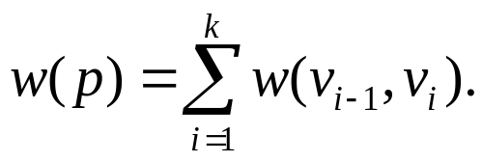
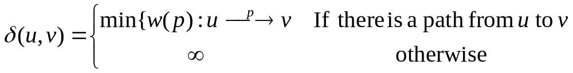
8.3 The shortest path problem
The shortest-paths problem: Given a weighted, directed graph G = (V, E), with weight function w : E → R mapping edges to real-valued-weights. The weight of path p =<v₀, v₁, ...,v_{k}> is the sum of the weights of its constituent edges:
The shortest-path weight from u to v can be defined as follows:
A shortest path from vertex u to vertex v is then defined as any path p with weight w(p) = δ(u,v).

Slide 84
The single-source shortest-paths problem
Given a graph G= (V, E), we want to find a shortest path from a given source vertex s ∈ V to each vertex v ∈V .
Single-destination shortest-paths problem
Find a shortest path to a given destination vertex t from each vertex v.
Single-pair shortest-path problem
Find a shortest path from u to v for given vertices u and v.
All-pairs shortest-paths problem
Find a shortest path from u to v for every pair of vertices u and v.

Slide 85


Slide 86
Optimal substructure of a shortest path
Theorem 8.7
Given a weighted, directed graph G = (V, E) with weight function w : E → R, let p = v₁,v₂,..., v_{k} be a shortest path from vertex v₁ to vertex v_{k} and, for any i and j such that 1 ≤ i ≤ j ≤k, let p_{ij} = v_{i}, v_{i+1},..., v_{j} be the subpath of p from vertex v_{i} to vertex v_{j} . Then, p_{ij} is a shortest path from v_{i} to v_{j}.

Slide 87
Representing shortest paths
1.The predecessor subgraph:
G_{π} = (V_{π}, E_{π}). Here
V_{π} = {v∈V :π[v] ≠ NIL}∪{s}.
E_{π} = {(π[v], v) ∈E : v∈ V_{π} - {s}} .
2. The shortest-paths tree: rooted at s is a directed subgraph G' = (V', E'), where V' ⊆ Vand E' ⊆ E, such that
1. V' is the set of vertices reachable from s in G,
2. G' forms a rooted tree with root s, and
3. for all v∈V', the unique simple path from s to v in G' is a shortest path from s to v in G

Slide 88
Relaxation
InitializeSingleSource(G, s)
1 for each vertex v∈V do
2 d[v] ← ∞
3 π[v] ← NIL
4 d[s] ← 0

Slide 89
The process of relaxing an edge (u, v) consists of testing whether we can improve the shortest path to v found so far by going through u and, if so, updating d[v] and π[v].
Relax(u, v, w)
1 if d[v] > d[u] + w(u, v) then
2 d[v] ← d[u] + w(u, v)
3 π[v] ← u

Slide 90
u
v
u
v
2
2
5
9
5
6
Relax(u,v)
Relax(u,v)
u
v
u
v
2
5
2
6
5
7

Slide 91
Properties of shortest paths and relaxation
Triangle inequality
For any edge (u, v) ∈E, δ(s, v) ≤δ(s, u) + w(u, v).
Upper-bound property
We always have d[v] ≥δ(s, v) for all vertices v ∈V , and once d[v] achieves the value δ(s, v), it never changes.
No-path property
If there is no path from s to v, then d[v] =δ(s, v) = ∞.
Convergence property
If s u v is a shortest path in G for some u, v∈ V, and if d[u] =δ(s, u) at any time prior to relaxing edge (u, v), then d[v] =δ(s, v) at all times afterward.

Slide 92
8.3.1 Algorithms for single-source shortest-paths problem
Bellman-Ford algorithm
Given a weighted, directed graph G = (V, E) with source s and weight function w : E → R, the Bellman-Ford algorithm returns a boolean value indicating whether or not there is a negative-weight cycle that is reachable from the source. If there is such a cycle, the algorithm indicates that no solution exists. If there is no such cycle, the algorithm produces the shortest paths and their weights.

Slide 93
BellmanFord(G, w, s)
1 InitializeSingleSource(G, s)
2 for i ← 1 to |V| - 1 do
3 for each edge (u, v)∈ E do
4 Relax(u, v, w)
5 for each edge (u, v) ∈ E do
6 if d[v] > d[u] + w(u, v) then return False
7 return True
Θ(|V|)
O(|V||E|)
O(|E|)
The running time O(|V||E|)

Slide 94
An example
t
5
x
BellmanFord(G, w, s)
1 InitializeSingleSource(G, s)
2 for i ← 1 to |V| - 1 do
3 for each edge (u, v)∈ E do
4 Relax(u, v, w)
5 for each edge (u, v) ∈ E do
6 if d[v] > d[u] + w(u, v) then return False
7 return True
6
-2
s
-3
8
7
2
-4
7
y
9
z
t
5
x
∞
∞
6
-2
s
-3
0
8
7
2
-4
7
∞
∞
y
9
z

Slide 95
t
5
x
BellmanFord(G, w, s)
1 InitializeSingleSource(G, s)
2 for i ← 1 to |V| - 1 do
3 for each edge (u, v)∈ E do
4 Relax(u, v, w)
5 for each edge (u, v) ∈ E do
6 if d[v] > d[u] + w(u, v) then return False
7 return True
∞
∞
6
-2
s
-3
0
8
7
2
-4
7
∞
∞
y
9
z
t
5
x
6
∞
6
-2
s
-3
0
8
7
2
-5
7
7
∞
y
9
z

Slide 96
t
5
x
BellmanFord(G, w, s)
1 InitializeSingleSource(G, s)
2 for i ← 1 to |V| - 1 do
3 for each edge (u, v)∈ E do
4 Relax(u, v, w)
5 for each edge (u, v) ∈ E do
6 if d[v] > d[u] + w(u, v) then return False
7 return True
6
∞
6
-2
s
-3
0
8
7
2
-5
7
7
∞
y
9
z
t
5
x
6
4
6
-2
s
-3
0
8
7
2
-4
7
7
2
y
9
z

Slide 97
t
5
x
BellmanFord(G, w, s)
1 InitializeSingleSource(G, s)
2 for i ← 1 to |V| - 1 do
3 for each edge (u, v)∈ E do
4 Relax(u, v, w)
5 for each edge (u, v) ∈ E do
6 if d[v] > d[u] + w(u, v) then return False
7 return True
6
4
6
-2
s
-3
0
8
7
2
-4
7
7
2
y
9
z
t
5
x
2
4
6
-2
s
-3
0
8
7
2
-4
7
7
2
9
y
z

Slide 98
t
5
x
BellmanFord(G, w, s)
1 InitializeSingleSource(G, s)
2 for i ← 1 to |V| - 1 do
3 for each edge (u, v)∈ E do
4 Relax(u, v, w)
5 for each edge (u, v) ∈ E do
6 if d[v] > d[u] + w(u, v) then return False
7 return True
2
4
6
-2
s
-3
0
8
7
2
-4
7
7
2
9
y
z
t
5
x
2
4
6
-2
s
-3
0
8
7
2
-4
7
7
-2
9

Slide 99
BellmanFord(G, w, s)
1 InitializeSingleSource(G, s)
2 for i ← 1 to |V| - 1 do
3 for each edge (u, v)∈ E do
4 Relax(u, v, w)
5 for each edge (u, v) ∈ E do
6 if d[v] > d[u] + w(u, v) then return False
7 return True
t
5
x
2
4
6
-2
s
-3
0
8
7
2
-4
7
7
-2
9
TRUE

Slide 100
Dijkstra's algorithm
Dijkstra's algorithm solves the single-source shortest-paths problem on a weighted, directed graph G = (V, E) for the case in which all edge weights are nonnegative.
Dijkstra's algorithm maintains a set S of vertices whose final shortest-path weights from the source s have already been determined. The algorithm repeatedly selects the vertex u∈V – S with the minimum shortest-path estimate, adds u to S, and relaxes all edges leaving u.

Slide 101
Dijkstra(G, w, s)
1 InitializeSingleSource(G, s)
2 S ← Ø
3 Q ← V
4 while Q≠Ø do
5 u ← ExtractMin(Q)
6 S ← S ∪{u}
7 for each vertex v∈Adj[u] do
8 Relax(u, v, w)
The running time O(|V|²)

Slide 102
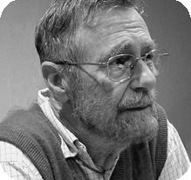
Programming and Algorithm
http://amturing.acm.org/award_winners/dijkstra_1053701.cfm

Slide 103
An example
Dijkstra(G, w, s)
1 InitializeSingleSource(G, s)
2 S ← Ø
3 Q ← V
4 while Q≠Ø do
5 u ← ExtractMin(Q)
6 S ← S ∪{u}
7 for each vertex v∈Adj[u] do
8 Relax(u, v, w)
t
z
1
10
s
9
2
3
4
6
7
5
x
2
y
t
z
1
∞
∞
10
s
9
S={}
0
2
3
4
6
7
5
Q
s
t
z
x
y
∞
∞
x
2
y
0
∞
∞
∞
∞

Slide 104
Dijkstra(G, w, s)
1 InitializeSingleSource(G, s)
2 S ← Ø
3 Q ← V
4 while Q≠Ø do
5 u ← ExtractMin(Q)
6 S ← S ∪{u}
7 for each vertex v∈Adj[u] do
8 Relax(u, v, w)
t
z
1
∞
∞
10
s
9
0
2
3
4
6
7
5
∞
∞
x
2
y
t
z
1
10
10
∞
s
9
0
2
3
4
6
Q
s
t
z
x
y
7
5
∞
∞
∞
∞
0
10
5
5
∞
x
2
y
S={s}

Slide 105
Dijkstra(G, w, s)
1 InitializeSingleSource(G, s)
2 S ← Ø
3 Q ← V
4 while Q≠Ø do
5 u ← ExtractMin(Q)
6 S ← S ∪{u}
7 for each vertex v∈Adj[u] do
8 Relax(u, v, w)
t
z
1
10
10
∞
s
9
0
2
3
4
6
7
5
5
∞
x
2
y
t
z
1
10
8
14
s
9
Q
t
z
x
y
0
2
3
4
6
10
∞
∞
7
8
14
5
7
5
S={s, x}
5
7
x
2
y

Slide 106
Dijkstra(G, w, s)
1 InitializeSingleSource(G, s)
2 S ← Ø
3 Q ← V
4 while Q≠Ø do
5 u ← ExtractMin(Q)
6 S ← S ∪{u}
7 for each vertex v∈Adj[u] do
8 Relax(u, v, w)
t
z
1
10
8
14
s
9
0
2
3
4
6
7
5
5
7
x
2
y
t
z
1
10
8
13
s
9
Q
t
z
y
0
2
3
4
6
8
14
7
13
7
5
S={s, x, y}
5
7
x
2
y

Slide 107
Dijkstra(G, w, s)
1 InitializeSingleSource(G, s)
2 S ← Ø
3 Q ← V
4 while Q≠Ø do
5 u ← ExtractMin(Q)
6 S ← S ∪{u}
7 for each vertex v∈Adj[u] do
8 Relax(u, v, w)
t
z
1
10
8
13
s
9
0
2
3
4
6
7
5
5
7
x
2
y
t
z
1
10
8
9
s
9
Q
t
z
0
2
3
4
6
8
13
7
9
5
S={s, x, y, t}
5
7
x
2
y

Slide 108
Dijkstra(G, w, s)
1 InitializeSingleSource(G, s)
2 S ← Ø
3 Q ← V
4 while Q≠Ø do
5 u ← ExtractMin(Q)
6 S ← S ∪{u}
7 for each vertex v∈Adj[u] do
8 Relax(u, v, w)
t
z
1
10
8
9
s
9
0
2
3
4
6
7
5
5
7
x
2
y
t
z
1
10
8
9
s
9
Q
z
0
2
3
4
6
9
7
5
S={s, x, y, t, z}
5
7
x
2
y

Slide 109
Correctness of Dijkstra's algorithm
Theorem8.8 Dijkstra's algorithm, run on a weighted, directed graph G = (V, E) with non-negative weight function w and source s, terminates with d[u] = δ(s, u) for all vertices u ∈V.
Proof. We use the following loop invariant:
• At the start of each iteration of the while loop of lines 4-8, d[v] = δ(s, v) for each vertex v∈S.
Initialization: Initially, S = Ø, and so the invariant is trivially true.
Maintenance: We wish to show that in each iteration, d[u] = δ(s, u) for the vertex added to set S.

Slide 110
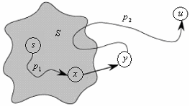
For the purpose of contradiction, let u be the first vertex for which d[u]≠δ(s, u) when it is added to set S.
There must be a shortest path p from s to u. Prior to adding u to S, path p connects a vertex in S, namely s∈ S, to a vertex in V - S, namely u. Let us consider the first vertex y along p such that y ∈ V - S, and let x ∈S be y's
predecessor.

Slide 111
We claim that d[y] = δ(s, y) when u is added to S.
We can now obtain a contradiction to prove that d[u] = δ(s, u). Because y occurs before u on a shortest path from s to u and all edge weights are nonnegative (notably those on path p2), we have δ(s, y) ≤ δ(s, u), and thus
d[y] = δ(s, y) ≤δ(s, u) ≤ d[u].
But because both vertices u and y were in V - S when u was chosen in line 5, we have d[u] ≤ d[y].
d[y] = δ(s, y) = δ(s, u) = d[u].

Slide 112
Consequently, d[u] = δ(s, u), which contradicts our choice of u. We conclude that d[u]= δ(s, u) when u is added to S, and that this equality is maintained at all times thereafter.
Termination: At termination, Q = Ø which, along with our earlier invariant that Q =V - S, implies that S = V. Thus, d[u] = δ(s, u) for all vertices u∈V.

Slide 113
8.3.2 Algorithms for all-pairs shortest-paths problem
We can solve an all-pairs shortest-paths problem by running a single-source shortest-paths algorithm |V| times, once for each vertex as the source.
Can we do better?
Unlike the single-source algorithms, which assume an adjacency-list representation of the graph, most of the algorithms in this chapter use an adjacency-matrix representation.

Slide 114
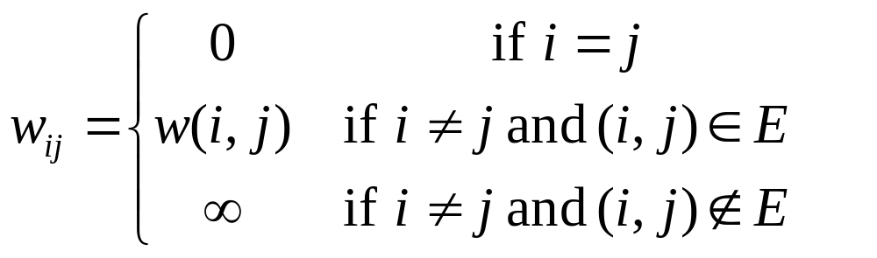
For convenience, we assume that the vertices are numbered 1, 2,..., |V|, so that the input is an |V| × |V| matrix W representing the edge weights of an |V| -vertex directed graph G = (V, E). That is, W = (w_{ij}), where
Negative-weight edges are allowed, but we assume for the time being that the input graph contains no negative-weight cycles.

Slide 115
Shortest paths and matrix multiplication
The structure of a shortest path
Consider a shortest path p from vertex i to vertex j, and suppose that p contains at most m edges. Assuming that there are no negative-weight cycles, m is finite. If i = j, then p has weight 0 and no edges. If vertices i and j are distinct, then we decompose path p into
where path p′ now contains at most m - 1 edges. By above Lemma, p′ is a shortest path from i to k, and so δ(i, j) = δ(i, k) + w_{kj}.
p′
i
k
j

Slide 116
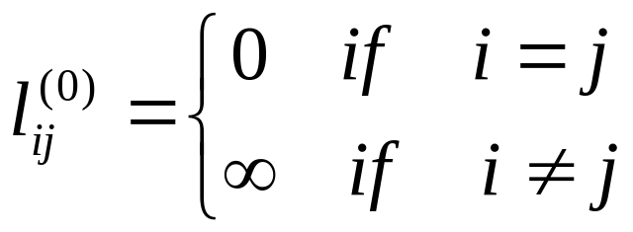
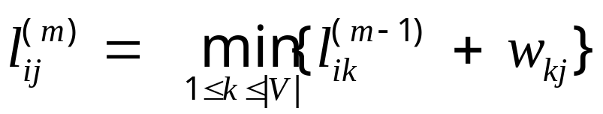
A recursive solution to the all-pairs shortest-paths problem
Let l_{ij}^{(m)} be the minimum weight of any path from vertex i to vertex j that contains at most m edges. When m = 0, there is a shortest path from i to j with no edges if and only if i = j. Thus,

Slide 117

What are the actual shortest-path weights δ(i, j)?
If the graph contains no negative-weight cycles, then for every pair of vertices i and j for which δ(i, j) < ∞, there is a shortest path from i to j that is simple and thus contains at most |V| - 1 edges. A path from vertex i to vertex j with more than |V| - 1 edges cannot have lower weight than a shortest path from i to j.
δ(i, j)= l_{ij}^{(|V|-1)}
Can we do better?

Slide 118
The Floyd-Warshall algorithm
The structure of a shortest path
The algorithm considers the "intermediate" vertices of a shortest path, where an intermediate vertex of a simple path p = v₁, v₂,..., v_{l} is any vertex of p other than v₁ or v_{l}, that is, any vertex in the set {v₂,..., v_{l-1}}.
Under our assumption that the vertices of G are V = {1, 2,..., |V|}, let us consider a subset {1, 2,..., k} of vertices for some k. For any pair of vertices i, j∈V, consider all paths from i to j whose intermediate vertices are all drawn from {1, 2,..., k}, and let p be a minimum-weight path from among them. (Path p is simple.)

Slide 119
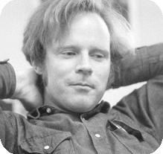
Robert W. Floyd
United States – 1978
http://amturing.acm.org/award_winners/floyd_3720707.cfm

Slide 120
The Floyd-Warshall algorithm exploits a relationship between path p and shortest paths from i to j with all intermediate vertices in the set {1, 2,..., k - 1}. The relationship depends on whether or not k is an intermediate vertex of path p.
If k is not an intermediate vertex of path p, then all intermediate vertices of path p are in the set {1, 2,..., k - 1}. Thus, a shortest path from vertex i to vertex j with all intermediate vertices in the set {1, 2,..., k - 1} is also a shortest path from i to j with all intermediate vertices in the set {1, 2,..., k}.

Slide 121
If k is an intermediate vertex of path p, then we break p down into
p₁
p₂
k
i
j
Path p is a shortest path from vertex i to vertex j with all intermediate vertices in the set {1, 2,..., k}.
p₁ is a shortest path from i to k with all intermediate vertices in the set {1, 2,..., k - 1}.
p₂ is a shortest path from vertex k to vertex j with all
intermediate vertices in the set {1, 2,..., k - 1}.

Slide 122
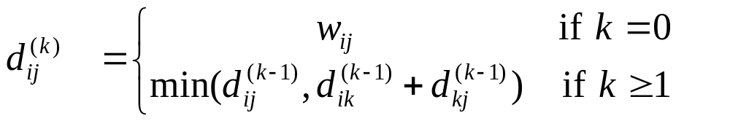
A recursive solution to the all-pairs shortest-paths problem
Let d_{ij}^{(k)} be the weight of a shortest path from vertex i to vertex j for which all intermediate vertices are in the set {1, 2,..., k}. When k = 0, a path from vertex i to vertex j with no intermediate vertex numbered higher than 0 has no intermediate vertices at all. Such a path has at most one edge, and hence d_{ij}⁽⁰⁾ =w_{ij}. A recursive definition following the above discussion is given by

Slide 123
Computing the shortest-path weights bottom up
FloydWarshall(W)
1 D⁽⁰⁾ ← W
2 for k ← 1 to |V| do
3 for i ← 1 to |V| do
4 for j ← 1 to |V| do
5 if d_{ij}^{(k-1)}<d_{ik}^{(k-1)} + d_{kj}^{(k-1)} then d_{ij}^{(k)} ←d_{ij}^{(k-1)}
6 else d_{ij}^{(k)} ←d_{ik}^{(k-1)} + d_{kj}^{(k-1)}
7 return D^{(|V|)}
Θ(|V|³)
How to construct a shortest path?

Slide 124
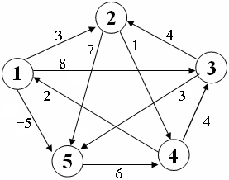
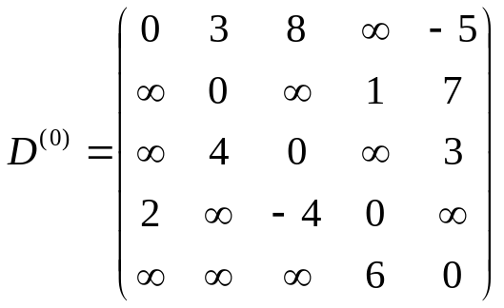
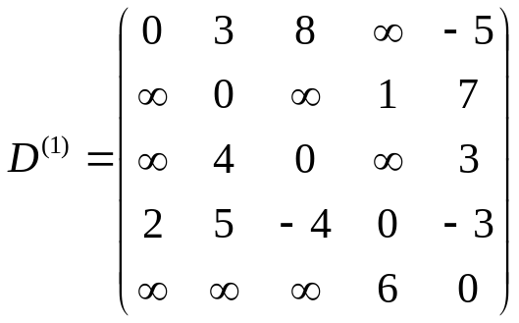
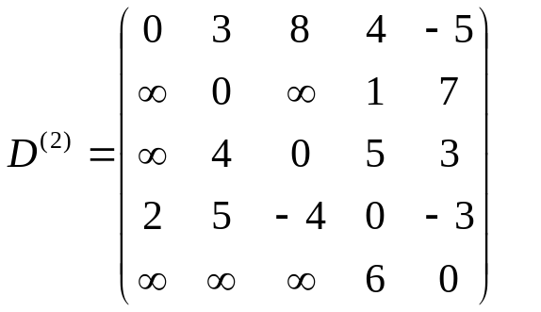
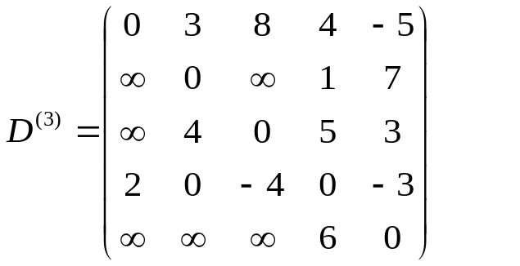
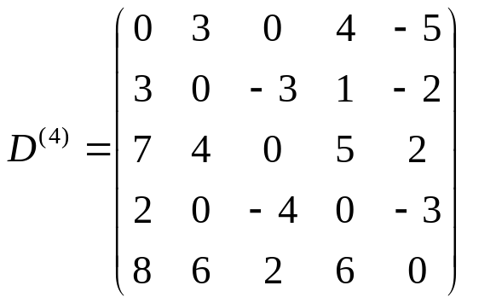
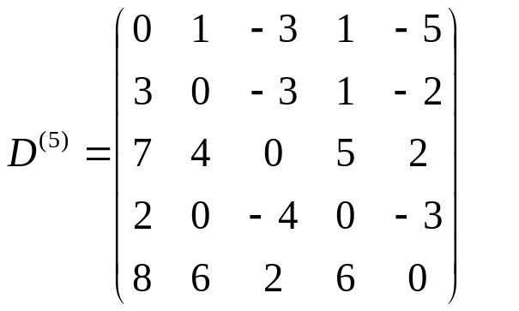

Slide 125
Homework
Page 135-137
  1. 8.2 8.5 8.6 8.7
  2. 8.8 8.9 8.10 8.19
  3. 8.22 8.27 8.29
  8.30和8.31至少两题

